Slide 1

Antra Gupta
1647209
MCA

Slide 2
What is MONEY?
Money is a ledger
Notes:
Ledger : collection of financial accounts

Slide 3
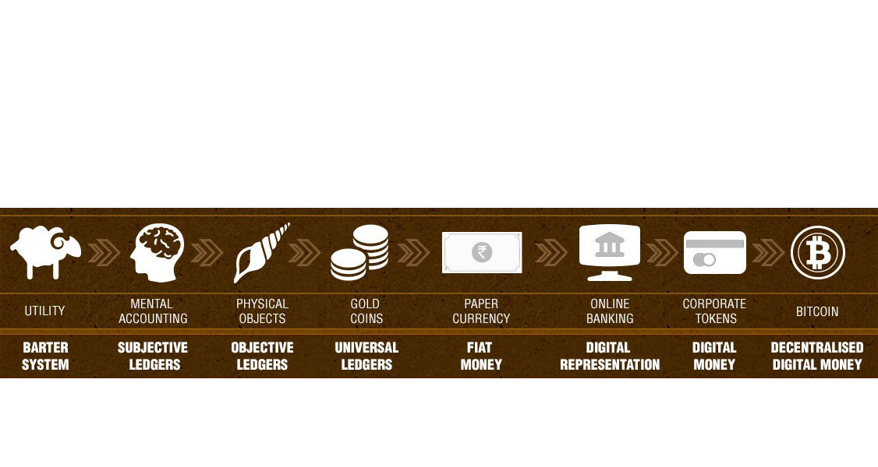
Evolution of Money

Slide 4
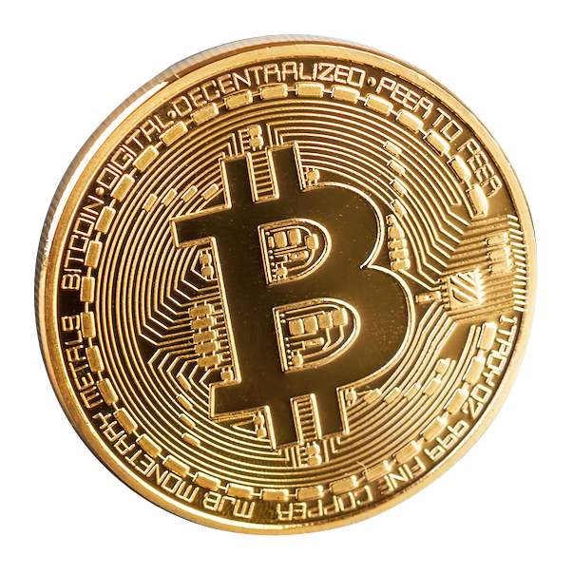
What is Bitcoin?
Bitcoin is a digital currency that functions through the internet and uses peer-to-peer technology to operate with no central authority governing the protocol. The issuing of bitcoin is carried out collectively by the network. It is open-source and free for everyone to be part of. It also has a payment system within its protocol which helps the transfer of value as instant as an email. Through its many unique properties, Bitcoin allows for exciting uses that is not covered by any existing payment system.

Slide 5


Slide 6
Why Bitcoin is called Digital Gold?
Durability
Transferability
Divisibility
Scarcity
Recognisability
Fungibility
Notes:
1) Durability. Both bitcoins and gold are almost perfectly durable. Bitcoins require the internet and bitcoin miners, but if we lose the internet we obviously have bigger problems. Gold may wear away slightly if not handled carefully.
3) Transferability. Bitcoins can be sent from one address to another in seconds. Gold must be physically transported and exchanged.
2) Divisibility. Bitcoin can be divided right now into individual satoshis, with 100,000,000 satoshis making up 1 BTC. Gold can also be divided, but not nearly as easily or as precisely.
4) Scarcity. The bitcoin protocol results in a hard limit of 21,000,000 bitcoin units that will ever exist, of which 14,925,900 have already been issued. The scarcity of gold varies depending on how much effort is being expended to find it and how much of it is found.
5) Recognizability. Bitcoin is easy to recognize and impossible to counterfeit. Gold is pretty recognizable, though it must be tested for purity under some circumstances.
6) Fungibility. Bitcoin is usually totally fungible, where one bitcoin can substitute for any other. However, because bitcoins are all tracked on the blockchain, it is possible that governments may consider certain bitcoins tainted somehow, which might make bitcoin slightly less fungible. Mixing services will always preserve fungibility in some form though. Gold, if melted and purified, can not be tracked so easily, albeit it can be easily tagged in ways that are hard to detect and remove.

Slide 7
How bitcoin works?

Slide 8

How Bitcoin works?

Slide 9

Bitcoin = Blockchain?
Bitcoin = Crypto currency
Secure Ledger
Transparent and anonymous

Slide 10
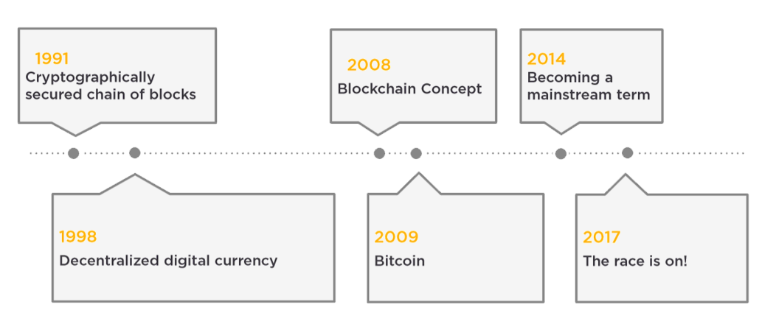
The Brief history of Blockchain
Notes:
Stewet Harward and scotts Tonena
Nicsabo
Satoshi nakamoto
Satoshi is considered the founder of bitcoins (Samsung, Toshiba, nakamichi, Motorola) no confirmation

Slide 11
Characteristics of Blockchain
Global Singelton
Accessible
Non-Stoppable
Verifyable

Slide 12
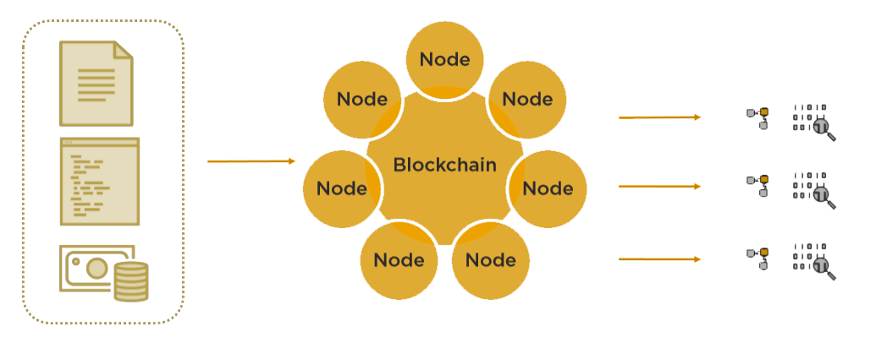
How does it work?
Transaction
Peer network of computer
Execution and Validation

Slide 13


Slide 14
Hashing
{output = roundToTen ( input * 2 )}
input = 5 gives output = 10
input = 4 gives output = 10
input = 3 gives output = 10
input = 9 gives output = 20
Notes:
The core of any blockchain reside in In the concept of hashing.
It is a mathematical algorithms
Length of alog is always same
It is digital figure print.( result of hasing is called hash)
It’s a one way function.
Any number 0-45

Slide 15
SHA 256
Original Text
SHA-256 Result
Christ University has three campuses in Bengaluru. The Main campus on the Hosur Road, one in Kengeri and the latest campus on the Bannerghatta road.
0BF3C2F69591919709A59F315CEA08169F3202C19F3C6E90891E6884A6B0AD98
Notes:
American national security agency
Family of hashing alogoriths

Slide 16
Common uses of Hashing Algorithms
Storing Passwords
Verify
Consistency
Security

Slide 17



Merkle Tree
D06DED8D16CE09D2CCA07C21910C678102D06F0D07DB461673481253DDAC2FC5
F028123EFB1E224F0198D323C533253156C0262AD48A73D31B537AAD9665EA57
01BA4719C80B6FE911B091A7C05124B64EEECE964E09C058EF8F9805DACA546B
‘Pear’
BF70552EB765992C6222A8C28B69F8AE8750BBCD0EE4AFED34F0CA6DB091D1D0
‘Apple’
F223FAA96F22916294922B171A2696D868FD1F9129302EB41A45B2A2EA2EBBFD
‘PC’
21D017C40A91C15748F0B98CD826BA445D2D3FE227E310BFD58DCB6C431826A0
‘MAC’
1F6368E6ECC0AA626F29AC4E81F7D034E5417D0BED2DCA558DDC9BE0ECD9D081

Slide 18
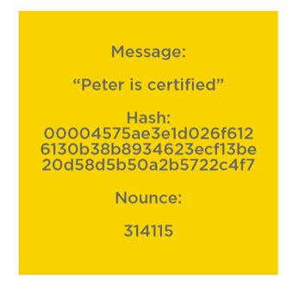
The Block

Slide 19
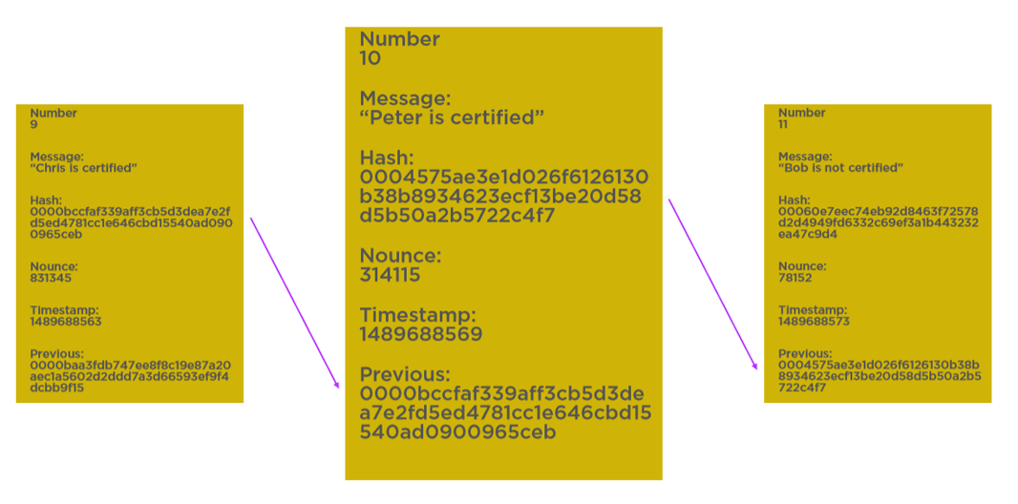
Chains of Blocks

Slide 20
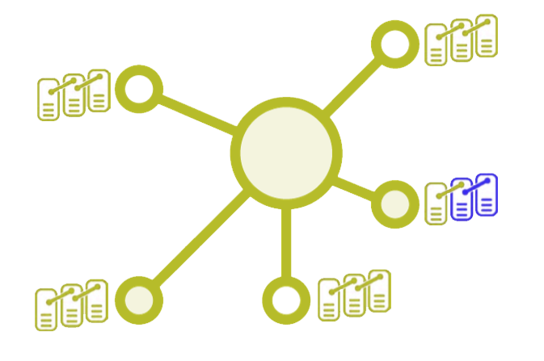
Distributed Chain of Blocks

Slide 21
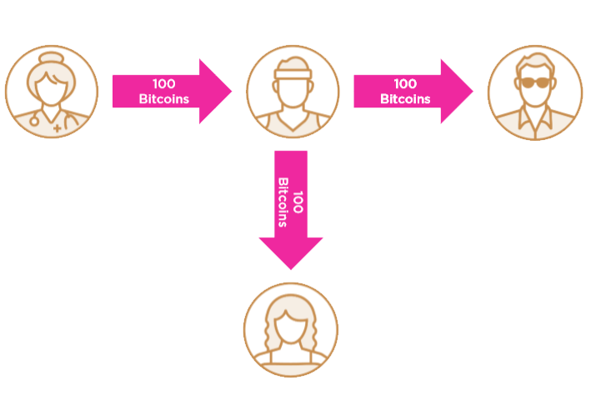
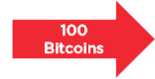
Fork

Slide 22
Securing Your Data
Obfuscation
Encryption

Slide 23
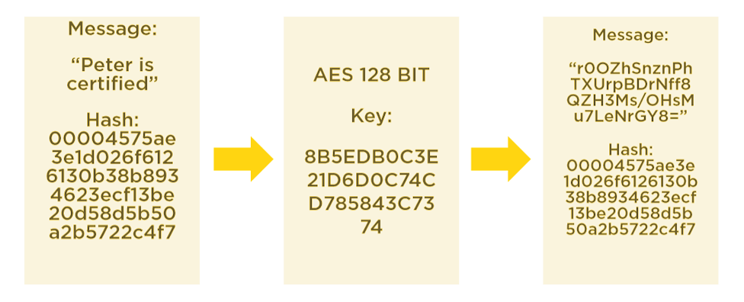
Encrypting a Message

Slide 24
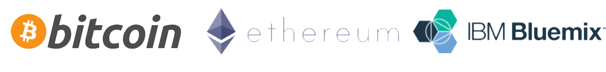
The Major Offering

Slide 25
Usage of Blockchain
Digital Currencies
Internet of Things
Product Lifecycle
Secure Information Sharing
Virtual Products
Certification

Slide 26

Top 10 facts of Bitcoins

Slide 27

Summary
Evolution of Money
Basics of Bitcoin
Basics of Blockchain
Hashing
The Blocks
Security
Implementation and Usages

